Slide 1
Conspiracy and community

Slide 2
After the shots
Why, after the crisis, what do we believe anymore?
After a crisis event, information including conspiracy spread more quickly than official investigations on the internet. We’re not going to trust the people who believe in those conspiracies; instead, we need to know where the distrust comes from, how it produces, complicate and enhanced by the media?

Slide 3
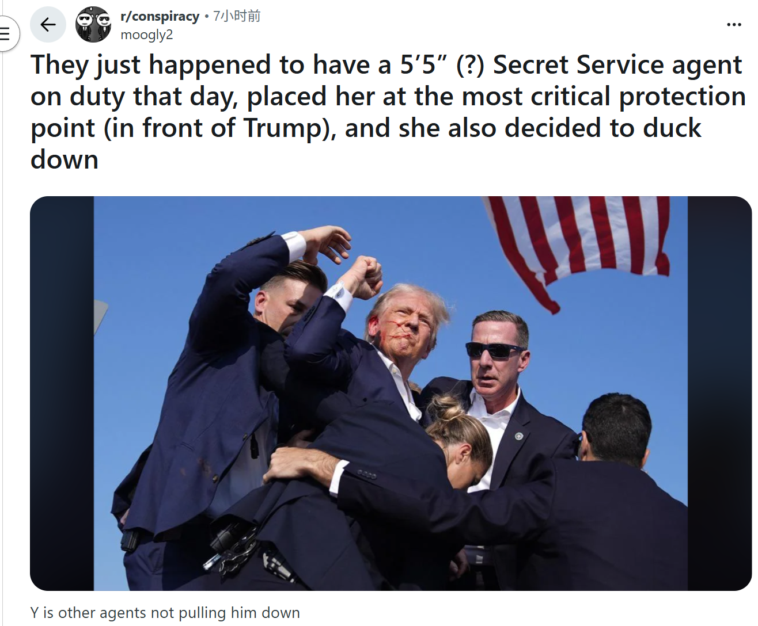
Method
Online ethnography
Non-participant observation.
Event: A failed assassination attempt.
Why Reddit: It is one of the oldest social platform and most active conspiracy communities on the internet.

Slide 4
Sample - Approximately 50-100 comments with 24 hour of incident. Making it suitable for observing the natural generation process of distrust narrative.
Collectives are a construction of affordances, pictures, posts, emotions and people.
The decision is made by parameters of research, including the number of posts, type of content to be analysed, as well as the duration of data collection. (Jonathan Collins, 2025)
Examples from the experts : manually gathered using Chapter2 Text to screen capture the text, each one daily. (Weekday) Top five posts of chosen subgroups to record the discursive forci, storing the data in a secured online database: especially on their likes, shares and comments. (Jonathan Collins, 2025).
Common uses of netnography include the consumption experience such as the reaction to advertising stimuli, consumer behaviour, consumer subculture , new product development...(Angele Delli Paoli, 2025).
We can identitfiy the patterns in age groups of the 18-25 demographic, gender, employment status, religion and poltical beliefs through the tiktok, twitter and reddit.
In the digital era, the interplay between narrative and identify takes on new dimension. These digital identities may be shaped through deliberate acts of self-presentation or emerge through collective engagement within groups, pages and online movements. (Hussein Hnit, 2025)

Slide 5
The data collected are anonymised, and the highlighted posts are obsecured to prevent reserve searching on the platform.
Gab Social is a public social media, where content is free to review without creating an account.
The benefits of the field in understanding far-right collectives outweighs potential negative consequences for the non-vulnerable community. Virtual immersive methods provide an unabtrosive fly-on-the-wall approach to examine online extreme community. (Jonathan Collins, 2025)
Screenshot after the post has been posted between 24-72 hours. The most notable comments (around 65 comments). Because of the dynamic algorithms, the post might out of the top criteria posts, however, it is not affecting the screenshot covers some unforgettable comments.
Positionality: we are figuring out how the reaction of communities in specific period rather than long term tracking.

Slide 6
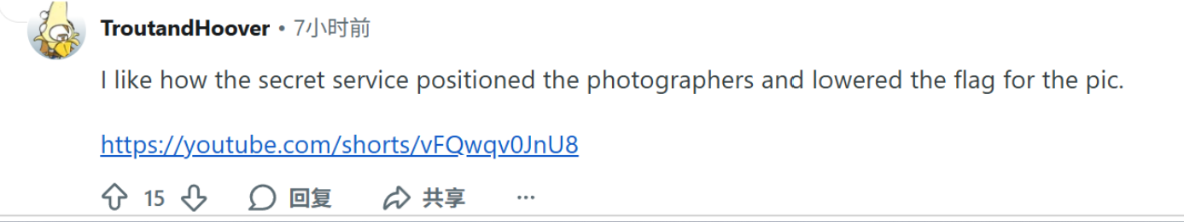
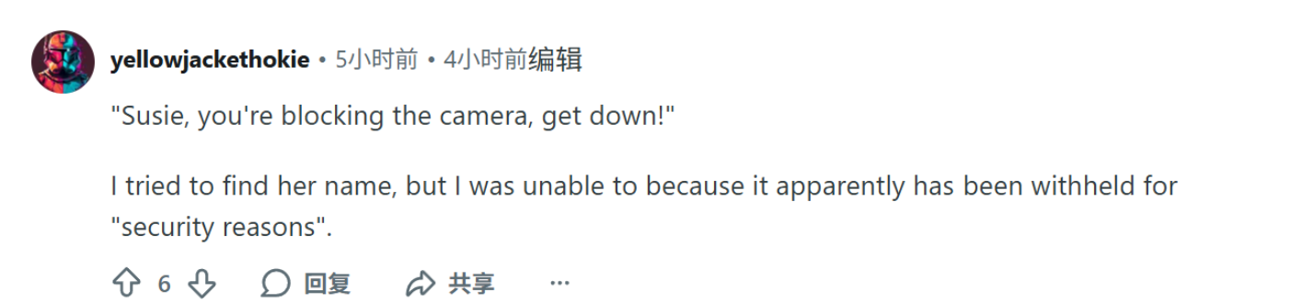
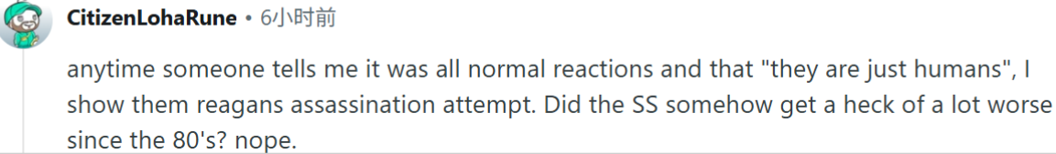
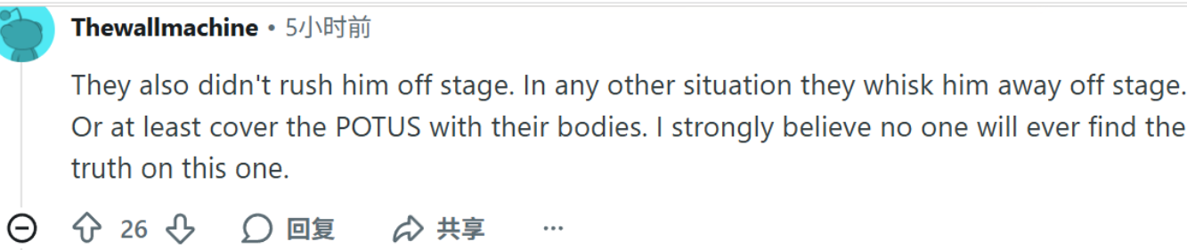
Main findings
Users like the investigators, they’re pointing out every single details. “I like how the sercret service positioned the photographers and lowered the pic for the pic.”
The work of women’s mission is stigmatized. “Susie, you’re blocking the camera, get down!”
“i tried to find her name, but i was unable because it apparently been withheld for “security reason”.
Denied of human’s lose. “Did the SS get a heck of a lot worse since the 80’s? nope.”
Truth is never going to be find out. “I strongly believe no one will ever find the truth on this one.”

Slide 7
The social consequences of conspiracy theory
Belief in conspiracy theories appears to be linked to difficulties in people’s personal relationships. (Cassidy Rowden). Contribute to feelings of social isolation, distance, and mistrust of others.
Mistrust in instutions, fulled by conspiracist thinkings.
It is therefore plausible to propose that the ever-increasing presence of conspiracy theories. Discourage citizens from voting.

